Slide 1
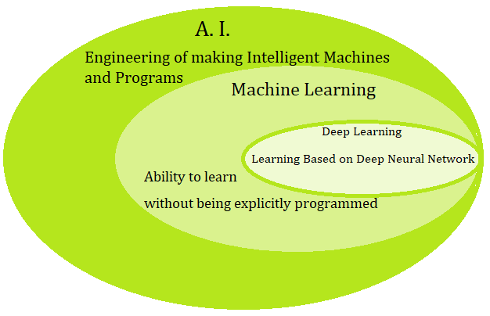
Introduction

Slide 2
AI
Data Pipelines (Huge amount of data)
Statistics
Computer Science
Domain Expertise
Computer Vision
Predictive Analytics

Slide 3
The main topics in AI
Artificial intelligence can be considered under a number of headings:
Search (includes Game Playing).
Representing Knowledge and Reasoning with it.
Planning.
Machine Learning.
Natural language processing.
Expert Systems.
Interacting with the Environment (e.g. Vision, Speech recognition, Robotics)

Slide 4
Areas of AI
Knowledge Representation
Search
Logic
Machine Learning
Planning
Expert Systems
NLP
Vision
Robotics

Slide 5
Why Machine Learning?
No human experts
industrial/manufacturing control
mass spectrometer analysis, drug design, astronomic discovery
Black-box human expertise
face/handwriting/speech recognition
driving a car, flying a plane
Rapidly changing phenomena
credit scoring, financial modeling
diagnosis, fraud detection
Need for customization/personalization
personalized news reader
movie/book recommendation

Slide 6
Dimensions of Learning Systems in ML
Type of feedback
Supervised (labeled examples)
Unsupervised (unlabeled examples)
Reinforcement (reward)
Semi-supervised learning
Representation
Attribute-based (feature vector)
Relational (first-order logic)
Use of knowledge
Empirical (knowledge-free)
Analytical (knowledge-guided)

Slide 7


Learning Methods
Supervised learning ( )
Prediction
Classification (discrete labels), Regression (real values)
Unsupervised learning ( )
Clustering
Probability distribution estimation
Finding association (in features)
Dimension reduction
Semi-supervised learning
Reinforcement learning
Decision making (robot, chess machine)

Slide 8
Supervised learning categories and techniques
Linear classifier (numerical functions)
Parametric (Probabilistic functions)
Naïve Bayes, Gaussian discriminant analysis (GDA), Hidden Markov models (HMM), Probabilistic graphical models
Non-parametric (Instance-based functions)
K-nearest neighbors, Kernel regression, Kernel density estimation, Local regression
Non-metric (Symbolic functions)
Classification and regression tree (CART), decision tree
Aggregation
Bagging (bootstrap + aggregation), Adaboost, Random forest

Slide 9
Unsupervised learning categories and techniques
Clustering
K-means clustering
Spectral clustering
Density Estimation
Gaussian mixture model (GMM)
Graphical models
Dimensionality reduction
Principal component analysis (PCA)
Factor analysis

Slide 10
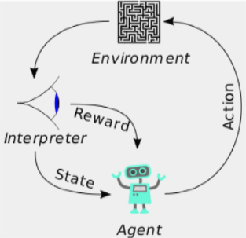
Reinforcement Learning
A computer program interacts with a dynamic environment in which it must perform a certain goal. The program is provided feedback in terms of rewards and punishments as it navigates its problem space.
Policies: what actions should an agent take in a particular situation
Utility estimation: how good is a state (→used by policy)
No supervised output but delayed reward
Credit assignment problem (what was responsible for the outcome)
Applications:
Game playing
Robot in a maze
Multiple agents, partial observability, ...

Slide 11
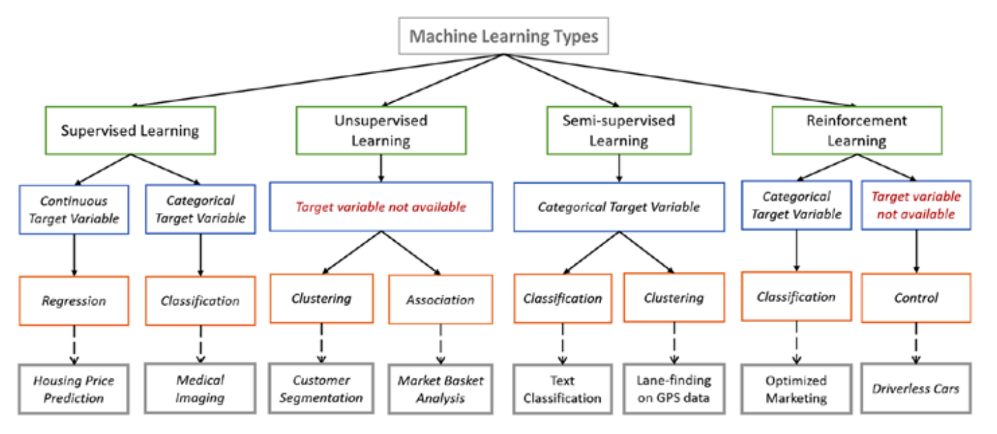
Image Source: https://towardsdatascience.com/types-of-machine-learning-algorithms-you-should-know-953a08248861

Slide 12
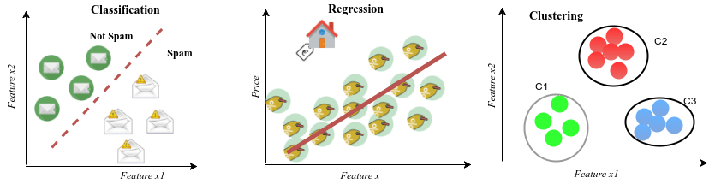
Examples of real-life problems in the context of supervised and unsupervised learning tasks: Spam filtering as a classification task and House price estimation as a regression task are part of supervised learning; Clustering is part of unsupervised learning in which customers are grouped into three different categories based on their purchasing behavior.
Image Source: DEEP GENERATIVE MODELS FOR SYNTHETIC RETINAL IMAGE GENERATION, Lappeenranta University of Technology, July 2017

Slide 13
Research issues in Machine Learning
Handling large amount of data
Training Time is more (Hours or Days)
Labeling of data or labeling of Images & Videos
Processing Performance for Training and Testing (Validating)
Accessing Reference Model – Transfer Learning
Optimizing Hyper parameters
Rapid and Optimized deployment
Curse of Modularity
Class Imbalance
Feature Engineering
Variance and Bias
Applications specific training – Less Generalization

Slide 14
Growth of Machine Learning – Current State
Machine learning is preferred approach to
Speech recognition, Natural language processing
Computer vision
Medical outcomes analysis
Robot control
Computational biology
This trend is accelerating – Deep Learning…
Improved machine learning algorithms
Improved data capture, networking, faster computers
Software too complex to write by hand
New sensors / IO devices
Demand for self-customization to user, environment

Slide 15
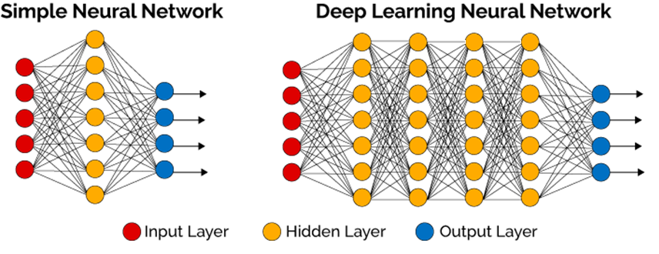
Deep Learning – A Definition
Deep Learning is a subﬁeld of Machine Learning which uses computational models, with hierarchical architectures composed by multiple processing layers, to learn representations of complex data such as images, sound and text.
Image Source: https://www.linkedin.com/pulse/intuition-deep-neural-networks-abhishek-parbhakar

Slide 16
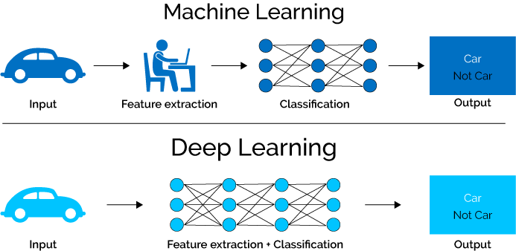
Difference between ML and DL
Image Source: https://www.xenonstack.com/blog/log-analytics-with-deep-learning-and-machine-learning

